Slide 1
What are the main file components of the Automation framework built for Selenium?
1.
Framework Built in TestNG
Framework Built in Cucumber
1. TestNG file ( .xml extension)
Contains name of the test folder, classes , methods.
Executes of test cases in groups.
Allows parallel execution.
Include/exclude test methods during execution.
Allows execution of multiple test cases from more than one classes.
1. Feature file (.feature extension)
Contains on or many test scenarios in plain text.
All tests are in form of Given, When, Then, And , Feature, Background, Scenario and Scenario Outline, But.
2. Step Definition file ( .java extension)
Mapping of every step of test scenarios in Feature file to the automation code.
3. Test Runner file (.java extension)
Interlink between Feature file and Step Definition file.
Provides option to run a single or multiple feature files.
Contains the location of the Feature and Step Definition file.

Slide 2
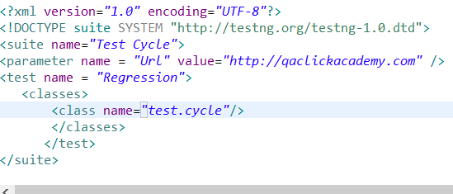

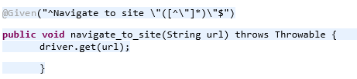
How do you handle single data parameterization in Automation Frameworks ?
2.
Framework Built in TestNG
Framework Built in Cucumber
testNG File
Here the testNG xml file contains the site Url
Class File
@Parameter({“Url”})
@Test
public void Login(String url){
driver.get(url);
}
The corresponding test method in the class file
Feature File
Here the Feature file contains the site Url.
Step Definition File
The corresponding mapping of the feature file to the step definition file.

Slide 3
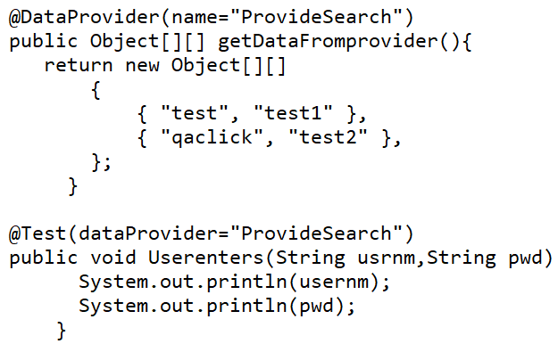
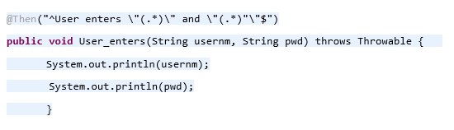
How do you handle multiple data parametrizations in Automation Frameworks ?
3.
Framework Built in TestNG
Framework Built in Cucumber
Class File
DataProvider attribute helper used for parameterizing.
Feature File
Feature: Login Feature
Scenario Outline: Login Test
Given User is on Login Page
When title of login page is QAClick
Then User enters "<username>" and "<password>“
Examples:
| username | password |
| qaclick | test#123 |
| test | t123 |
Step Definition File
The corresponding mapping of the parametrized Then in feature file .

Slide 4
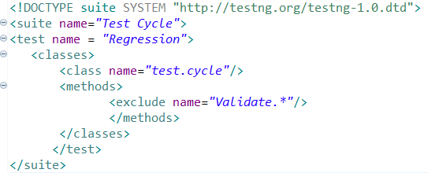
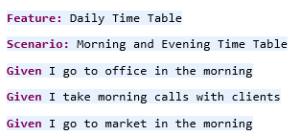
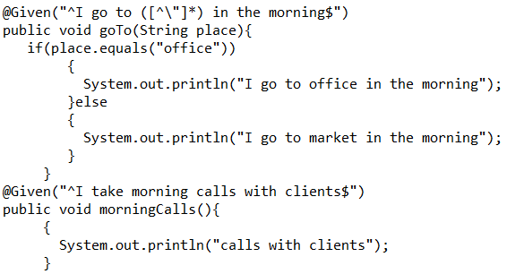
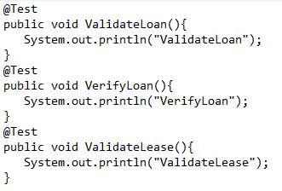
How to make use of regular expressions in Automation Frameworks ?
4.
Framework Built in TestNG
Framework Built in Cucumber
testNG File
Class File
Out of the three test methods, only VerifyLoan() will be executed, since we have excluded all the methods starting with name Validate using regular expression.
Feature File
Step Definition File
Here, @Given("^I go to ([^\"]*) in the morning$") maps two Given statements in Feature file using regular expression.

Slide 5
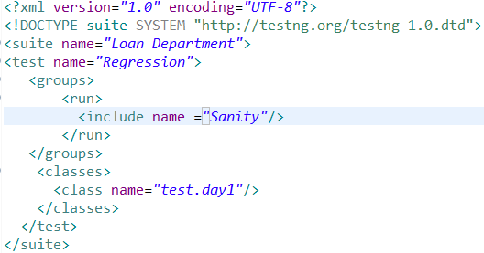
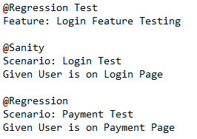
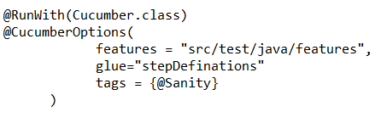
How to run selected tests from the set of test cases in Automation Frameworks ?
5.
Framework Built in TestNG
Framework Built in Cucumber
testNG File
Here the testNG xml contains group Sanity to be included in run.
Class File
@Test(groups={"Sanity"})
public void Login(){
System.out.println(“Login is successful”);
}
Only the test methods having groups as Sanity will be executed, out of the full regression suite.
Feature File
Here the Feature file contains the scenarios with tags Sanity and Regression.
Test Runner File
Test Runner File contains the tag @Sanity hence only the scenarios with Sanity tag will executed.

Slide 6
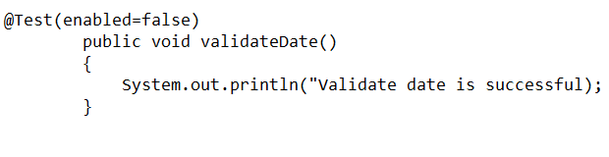
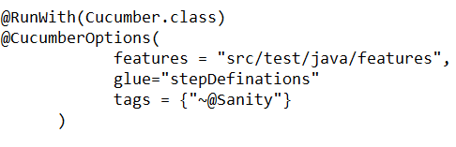
How to skip selected test method from the set of test cases in Automation Frameworks ?
6.
Framework Built in TestNG
Framework Built in Cucumber
Class File
Here the helper attribute enabled set to false is used to skip a particular test method from execution.
Feature File
Here the Feature file contains the scenarios with tags Sanity and Regression.
Test Runner File
In order to skip the scenarios with @Sanity , ~ is placed before @Sanity tag.

Slide 7
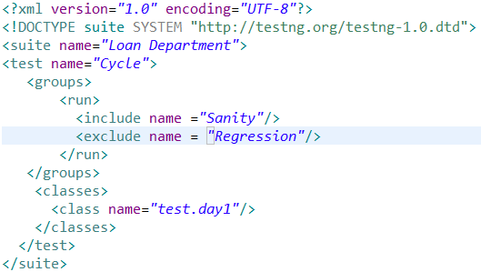
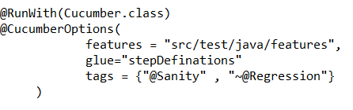
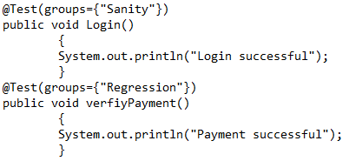
How to include and exclude test methods from set of test cases in Automation Framework ?
7.
Framework Built in TestNG
Framework Built in Cucumber
testNG File
Here the testNG xml contains group Sanity to be included and Regression to be excluded in run.
Class File
Feature File
Here the Feature file contains the scenarios with tags Sanity and Regression.
Test Runner File
Here the test runner file contains tag Sanity to be included and Regression to be excluded in run.

Slide 8
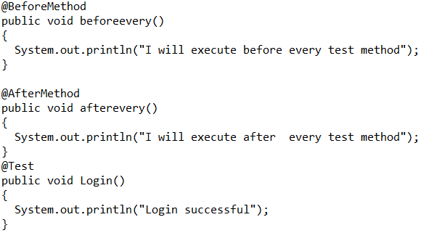

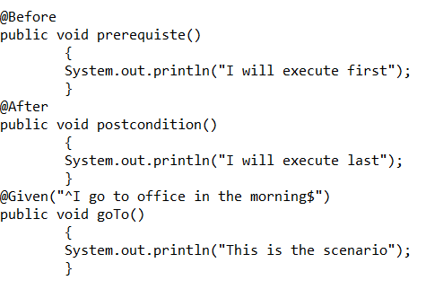
How to execute pre conditions and post conditions for each test method in Automation Framework?
8.
Framework Built in TestNG
Framework Built in Cucumber
Class File
First the method with tags @BeforeMethod will be executed (pre condition), followed by the test method ( Login() ) and finally the @AfterMethod will be executed(post condition).
Feature File
Feature file contains the above scenario.
Step Definition File
.
First the method with hook @Before will be executed (pre condition), followed by the test method ( goTo() method) and finally the @After will be executed(post condition).

Slide 9
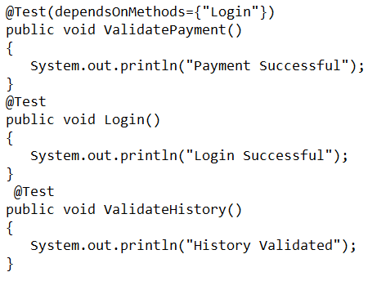
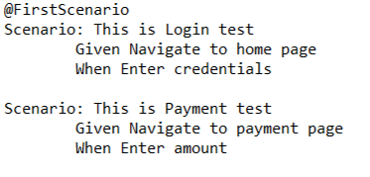
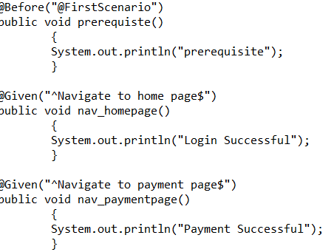
How to execute pre conditions for a particular scenario in Automation Framework ?
9.
Framework Built in TestNG
Framework Built in Cucumber
Class File
Here dependsOnMethods helper attribute is used. ValidatePayment() will only be executed after Login() precondition is ran successfully . But ValidateHistory() runs independently without having a pre condition test method to be executed.
Feature File
Step Definition File
.
Here precondition prerequisite() has to be run successfully before nav_homepage() but nav_payment() runs independently.

Slide 10
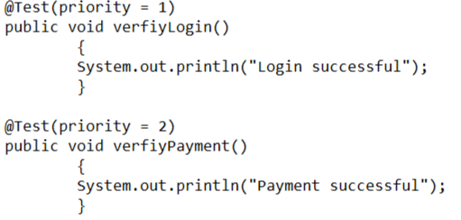
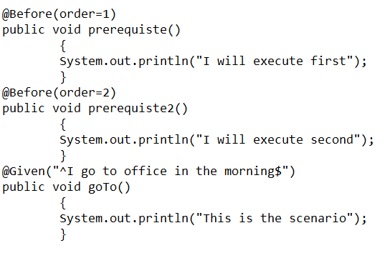
How to set priority for execution in Automation Framework ?
10.
Framework Built in TestNG
Framework Built in Cucumber
Class File
Here each test method is assigned with priority . Test method with lower priority will be executed first followed by the test method having higher priority. verifyLogin() will be executed first then verifyPayment().
Step Definition File
.
Here each test method is assigned with order. Test method with lower order (prerequisite()) will executed first . Then prerequisite2() test method will be executed which is having a higher order.
Once these pre conditions get executed successfully test method goTo() will be executed.

Slide 11
What are the different annotations available in TestNG?
11.
@Test
@BeforeSuite
@AfterSuite
@BeforeClass
@AfterClass
@BeforeTest
@AfterTest
@BeforeGroups
@AfterGrroups
@BeforeMethod
@AfterMethod

Slide 12
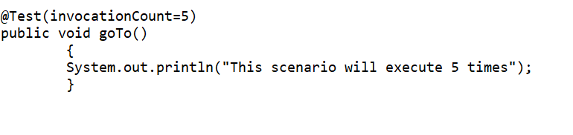
What is invocation count in TestNG?
12.
If we are required to execute a test case N number of times , then invocationCount helper attribute is used.
In the above example , This scenario will execute 5 times will print on the console five times.

Slide 13
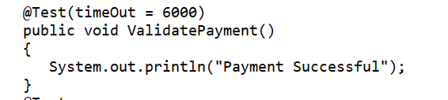
What is timeOut in TestNG?
13.
If there any test method that consumes a lot of time for execution ,we can terminate that method with the help of timeOut helper attribute in TestNG.
After 6000ms , the test method will be terminated and will be marked as Failed.

Slide 14
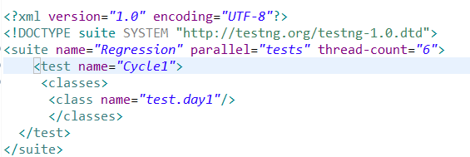
How to achieve parallel execution in TestNG?
14.
We use parallel attribute in testng.xml to achieve parallel execution in TestNG. It also has a parameter called as thread-count .The parallel can have the following values:
Tests
Classes
Methods
Instances
In the above example , execution will happen in parallel mode for tests , having thread- count of 6.

Slide 15
Explain the advantages of Cucumber.
15.
Some of the advantages of cucumber are as the followings:
Involves the business stake holders who are not having coding knowledge.
Its is an open source tool.
Integration with tools like Eclipse is easy.
It reduces communication gaps among Business Analyst, Developers and QA in an Agile environment.
Plain text representation makes it easy to understand for non technical individuals.
It is easy to maintain and work with.

Slide 16
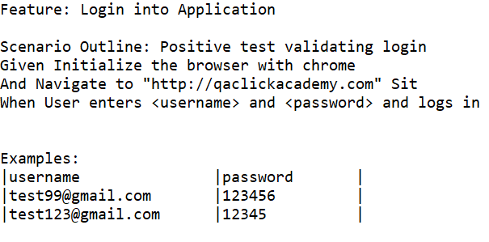
What is Scenario Outline in Cucumber ?
16.
Scenario Outline is the same scenario being executed for multiple data in multiple combinations. The data set is represented in form of table separated by (||). Each row constitute a set of data.
In the above example , When having <username> and <password> will be executed with three combinations of data defined under Examples separated by (||).

Slide 17
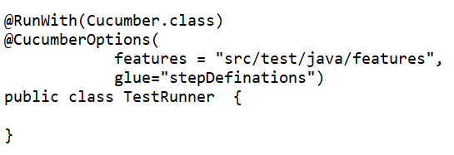
What is the use of glue in Cucumber Options tag ?
17.
Cucumber Identifies the location of the step definition files from the glue property in Cucumber Options tags.

Slide 18
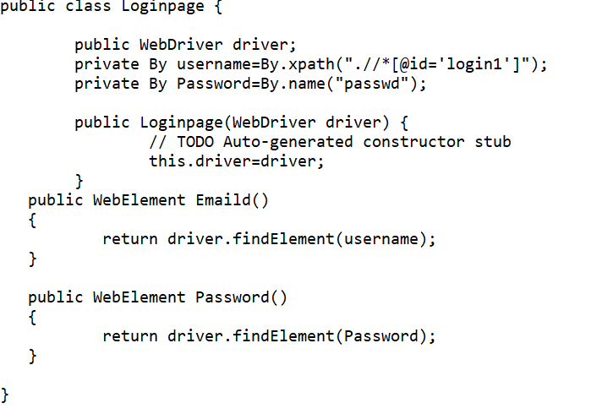
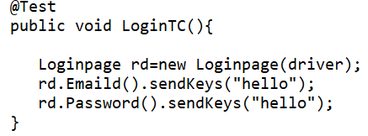
How will we achieve encapsulation in our Automation Framework ?
18.
Encapsulation means enclosing anything in a container . It is done to hide details and it is achieved by the help of
access modifiers like public , protected and private.
Here we have declared the variables as private and methods accessing them as public. Thus , while we are creating the objects , we are not handling them directly but with the help of the methods , thus keeping variables intact.
.
In our POM the locators are private, and we access them using public methods

Slide 19
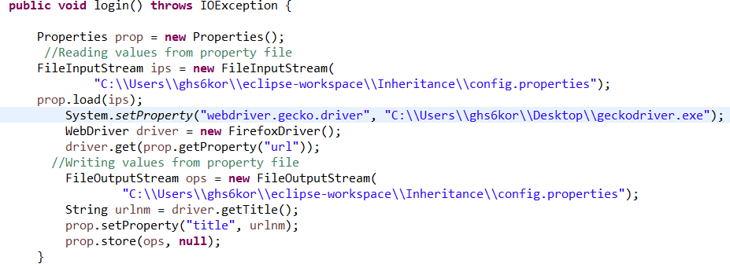
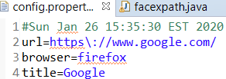
How will we declare global variables in Automation Framework ?
19.
We can declare global variables in Automation Framework with the help of the Properties class and a properties file . The properties file
contains global variables in the form of key – value pairs. We can read and write values in the .properties file.
Class File
Properties File
The title key writes the value Google in the properties file. It reads the keys url.

Slide 20
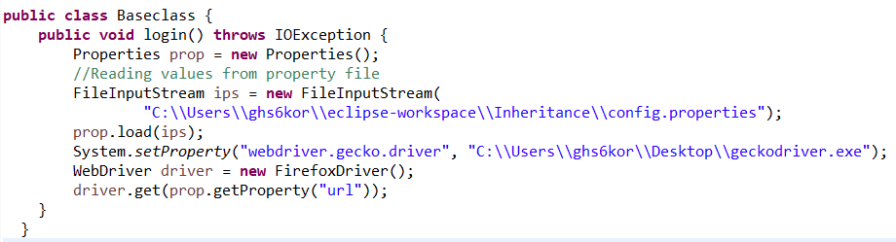
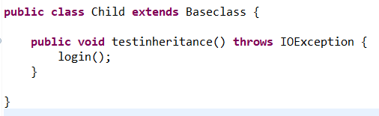
How do you deal with reusable components in Automation Framework ? How did you use Inheritance in your Automation Framework ?
20.
We have one base class where we have defined all the reusable methods and components. We used those reusable methods in our actual tests by inheriting that base class.
We can deal with the reusable components in Automation Framework with the help of inheritance concept . It’s a parent child relationship where the child inherits the properties of the parent class.
Parent Class
Child Class
Here the Child class extends the Baseclass and calls the login() method from it thereby achieving reusability of code.

Slide 21
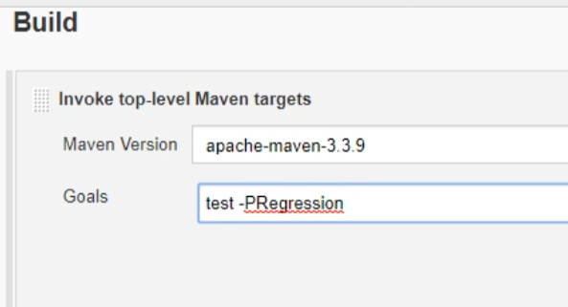
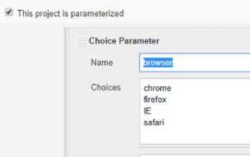
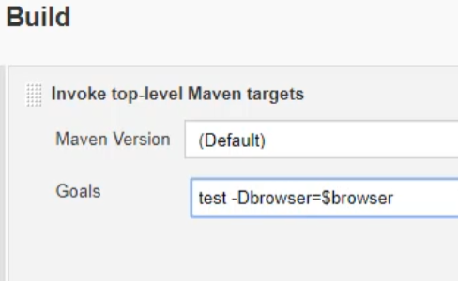
How to run Automation Framework from Jenkins ?
21.
We can run Automation Framework from Jenkins with the help of Maven commands. We need to first configure Java and Maven paths in
Jenkins. Then while creating the Jenkins jobs , the select Invoke top-level Maven targets from the Build section.
Here in the Goals , we need to provided the Maven commands.
test –PRegression is the specific command to trigger build without parameters.
Parameterize Jenkins Build
Here first the parameters are defined in Jenkin jobs. Then the Maven Goals is set with test –Dbrowser=$browser, with parameter browser.

Slide 22
How do we arrange locators in Automation Framework ?
22.
We can arrange locators in Automation Framework in Page Object Model in the following way:
Segregate locators for a particular screen in separate Java class. For example , LoginPage java class will contain objects with respect to that screen. While the PaymentPage java class will contain objects with respect to that screen.
The test cases are maintain in different Java classes where we will use the locators by calling the objects from that particular page ( for example , LoginPage) to the test case.
In case of any locator needs to be updated/deleted , we need to modify them to that particular java class for that specific screen and not every where.
Easy to use and maintain.

Slide 23
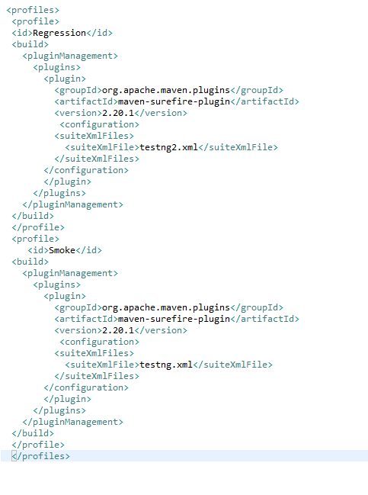
Which is the Maven command to achieve profiling?
23.
We can do profiling in Maven using the command : mvn test –PSmoke
Pom file
Here we have defined two profiles with Id Regression and Smoke. With the command ,
given above we will be able to trigger the test cases with profile id Smoke pointing to the
testng.xml file. In this way , we can have N number of TestNG xml files driven by a single
pom file.
Similarly , to trigger the execution with profile Id Regression , Maven command is :
mvn test –PRegression . In this case , testng2.xml file will be pointed.

Slide 24
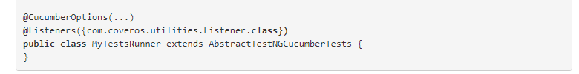
How to capture Screenshot automatically on Test Failure in the Framework
24.
Using TestNG Listeners
public void onTestFailure(ITestResult result) {
// Selenium Screenshot Method
}
Cucumber do not have Listeners by default. We should Integrate it with TestNG to enjoy the features of Cucumber

Slide 25
How do you manage code when multiple people in the team contributing for the Framework
25.
Using Version Control Tools like
GIT
SVN

